Slide 1
Power, marx and class
Domination and identity part 1

Slide 2
Sociology:
Sociology is a uniquely critical and empowering way of understanding and engaging with the world we live in.
It is a habit of mind that allows and encourages us to understand specific lived experiences and that they are shaped by:
How societies are run and organized
How societies change over time
How groups have more power than others
How less powerful groups sometimes come together and bring about change in society

Slide 3
Summary: sociological imagination
C. wright mills
what is a ‘’Social Science’’ and what it means to think ‘’socially’’, to think about an individual and the role that individual plays in Society
‘’Neither the life of an individual nor the history of a society can be understood without understanding both’’

Slide 4
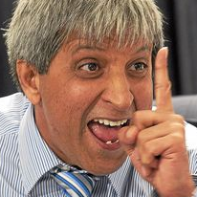
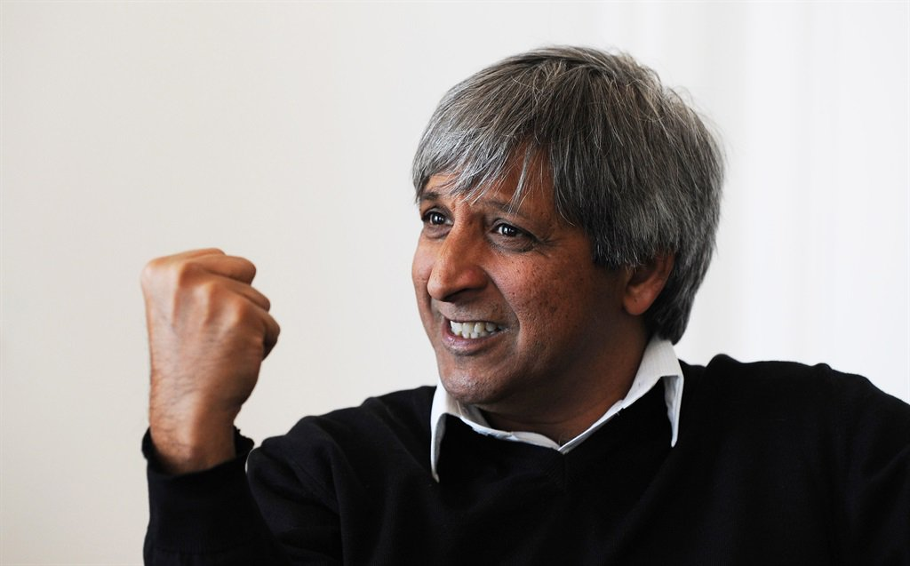
Power vs authority

Slide 5
Power
Max weber: German sociologist ( 1864-1920)
Michel Foucault: French Philosopher (1926-1984)
KARL MARX: BADASS ( 1818-1883)

Slide 6
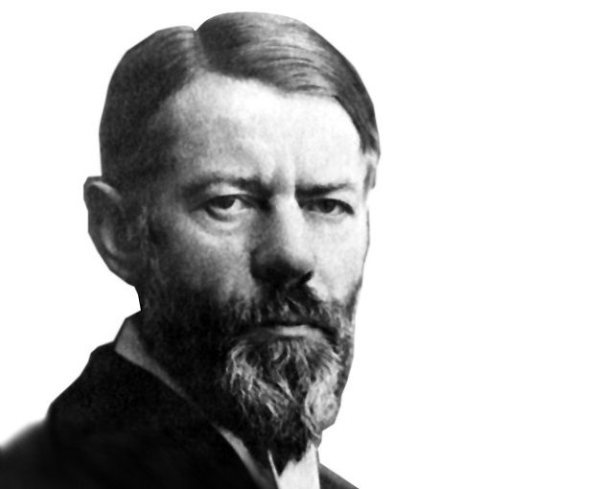
Weber: Power as situational/of personal influence
Authoritative or coercive
Power is the ability of an individual or group to achieve their own goals or aims when others are trying to prevent them from realising them”.
Power is the capacity someone has to control, dominate or direct others.

Slide 7
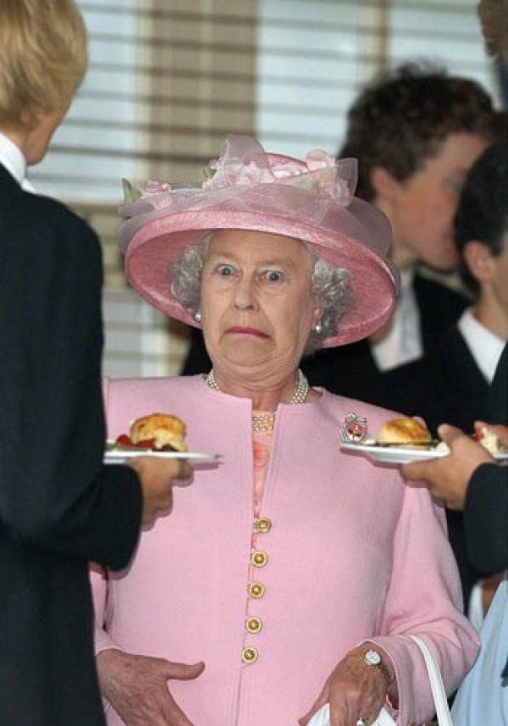
Power can be traditional or inherited to appear legitimate

Slide 8
Foucault: POWER TRANSCENDS POLITICS power that is structural/ hegemonic/domination
POWER IS EVERYWHERE BECAUSE IT COMES FROM EVERYWHERE
MOVES AWAY FROM WEBERS INDIVIDUALISTIC APPROACH TO POWER
flows through our understandings of knowledge or truth
organisations don’t hold or pocess power- they embody it.
Power is not purely behavioral: it shapes perceptions as well as behavior.
Much broader than public policy or formal politics.

Slide 9
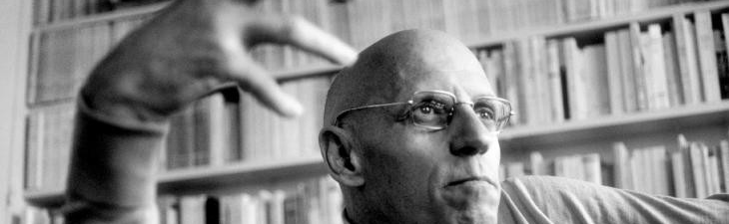
The ideas we hold to be true are the ideas that hold the most power.
The knowledge we assign the most value is the knowledge that has the most power

Slide 10
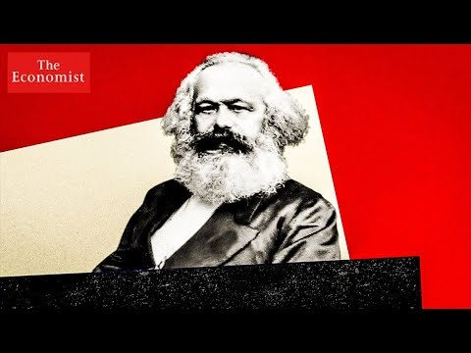
KARL MARX
GERMAN PHILOSOPHER
HISTORIAN
SOCIOLOGIST
POLITICAL THEORIST
JOURNLAIST
REVOLUTIONARY

Slide 11
‘’WHAT DOES IT MEAN TO BE FREE?’’
The Economy: the organization of labour and resources in a society
Critical questions to understand the economy
HOW IS LABOUR ORGANISED?
WHO DOES THE LABOUR?
HOW DOES LABOUR CHANGE OVER TIME?

Slide 12
Social Class
‘
’relations of production’’: how the surplus is taken from the people who produce it and who gets to decide how that surplus is used.
Class is defined by ones place in the relations of production
Karl Marx saw two main classes:
The working class/ Proletariat: don’t own or control means of production
The capitalists/ Bourgeois: control and own the means of production

Slide 13

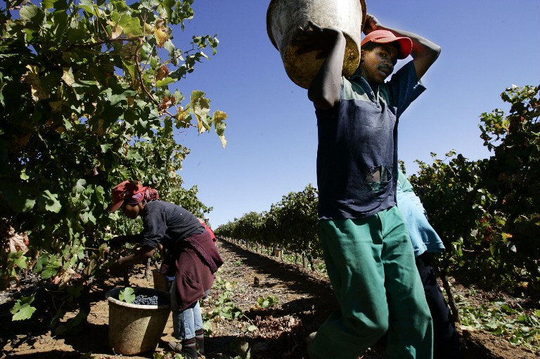
If the proletariat lack access to the means of production the only thing they can sell is their labour.

Slide 14
Marx: PROBLEMS WITH CAPITALISM
Modern work is Alienated- a feeling of disconnection between the work and the outcome/ the work and the beneficiary
Modern work is insecure- human beings are expendable in production so when costs rise and when savings can be made by increasing the role of technology- anyone is expendable
Workers get paid little while capitalists get rich- capitalists shrink the wages of the laborers as much as possible in order to skim off a wide profit margin- primitive accumulation.

Slide 15
‘’Capitalism is unstable’’

Slide 16
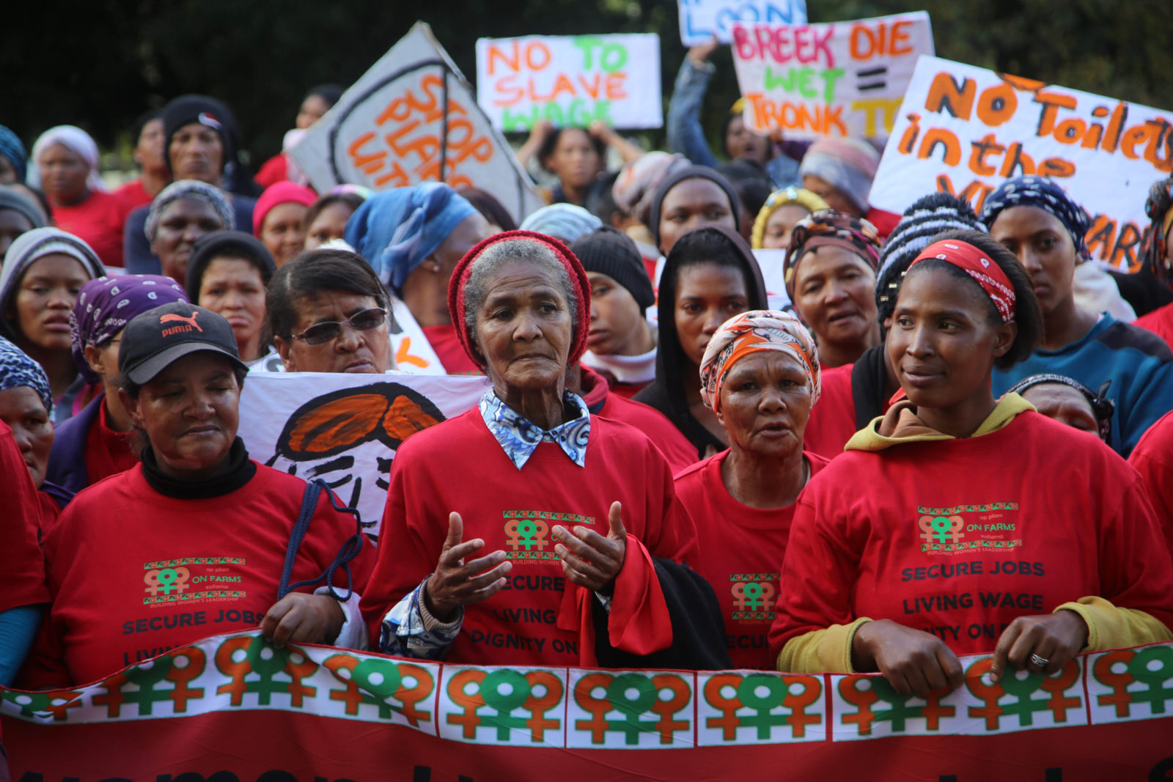

Slide 17
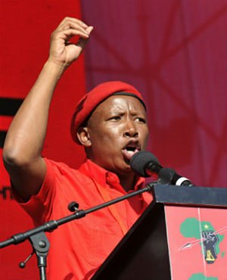
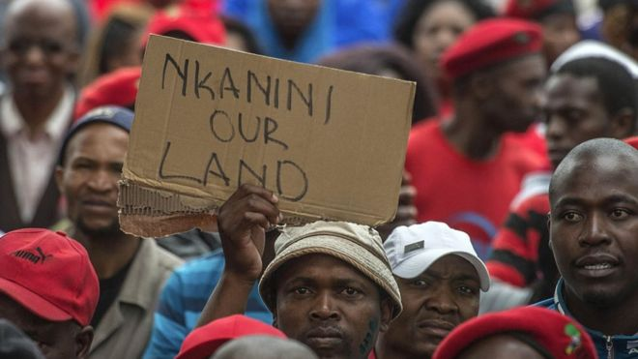

Slide 18
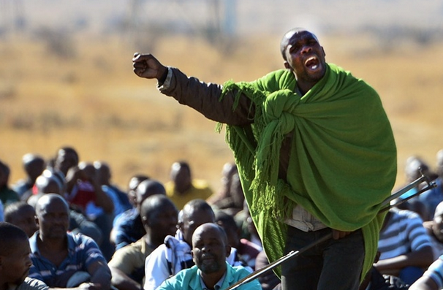
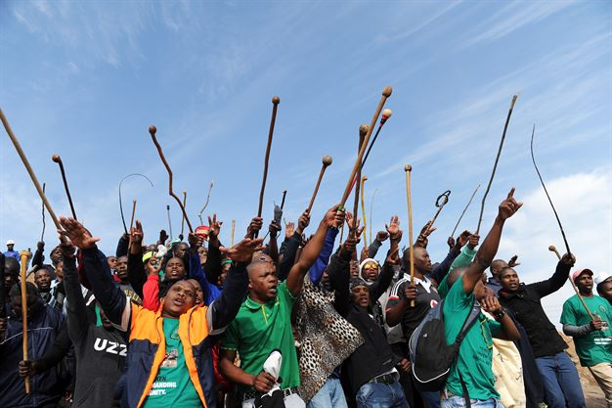

Slide 19
Class and work in the modern world?
As of 2012, the global labor pool consisted of approximately 3 billion workers, around 200 million unemployed.

